Slide 1
Aligning the Means and the Ends:
Focus on Student Loans
COSUAA Annual Conference
Scottsdale, AZ − April 28, 2014
Lauren Asher, ljasher@ticas.org

Slide 2
TICAS
The Institute for College Access & Success (TICAS) is an independent, nonprofit research and policy organization.
We focus on financial aid’s role in supporting affordability, enrollment, persistence, and completion.
Our Project on Student Debt examines rising student debt and its implications for our families, economy and society.
We developed the policy framework and led the campaign for Income-Based Repayment (IBR), and built IBRinfo.org to raise awareness of IBR and related programs.

Slide 3
The Problem
Income gaps in college enrollment and graduation are widening.
These gaps can’t be closed by financial aid policy alone, but research shows that aid can increase enrollment, persistence, and completion.
So, how can federal student aid better ensure access and support success?

Slide 4
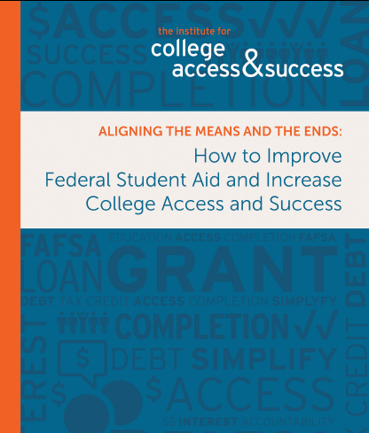
Topics Covered in Full Report
Student Eligibility and Accountability
College Eligibility and Accountability
Grant Aid
Student Loans
Tax Expenditures
Better Information
Ways to Pay for Reforms

Slide 5
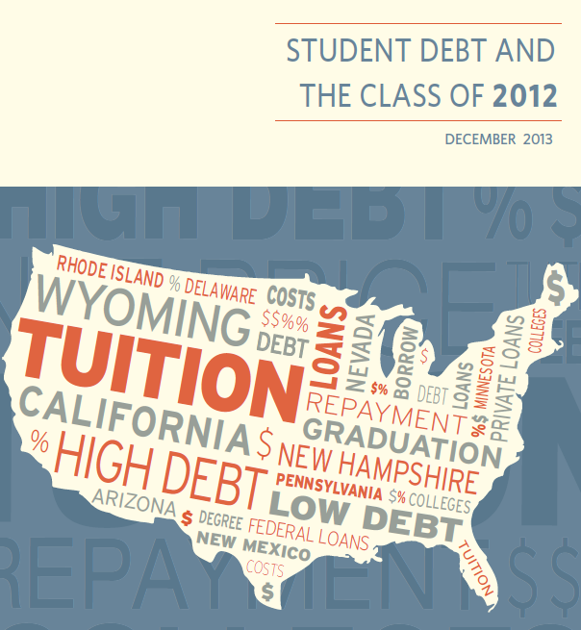
Rising Student Debt
Rising student debt:
Students are expected to cover costs that have outpaced family incomes and grant aid
Student loans help fill the growing gap
Our latest report on debt at graduation found:
71% of all graduating seniors in 2012 had loans
Borrowers’ average debt was $29,400
Up average 6% per year since 2008
At public four-year colleges and universities:
66% graduated with loans
Borrowers’ average debt was $25,500
High ≥$40,000, Low ≤ $6,000

Slide 6
Loans and Low-Income Students
Pell recipients are the most likely to borrow,
and they graduate with more debt.
To reduce the need to borrow, we need more state investment + more need-based aid.
Meanwhile, how can student loans better
support access, success, and affordability,
particularly for low-income students?

Slide 7
One Loan for Undergraduates
Replace subsidized and unsubsidized Stafford loans with one new type of loan, but keep current Stafford loan limits
Fixed interest rates and no fees
Low in-school interest rate based on government’s cost of borrowing
Higher, capped out-of-school rate
Interest-rate guarantee so borrowers in repayment aren’t stuck paying much higher interest rates than on new loans
Interest-free deferments for Pell Grant recipients
A limited menu of repayment options that are easy for borrowers to understand

Slide 8
Income-Based Repayment (IBR)
IBR was designed to help contain the real and perceived risks of borrowing as loans became more necessary.
There were woefully inadequate protections for borrowers who ended up with low earnings compared to their debt.
IBR helps ensure that monthly payments are manageable and provides a light at the end of the tunnel.
IBR is a critical safeguard for borrowers and can help reduce defaults.
IBR – and related plans– cannot fix rising costs or debt levels.
Loan repayment policy is just a piece of a much larger puzzle.

Slide 9
Too Many Income-Driven Plans
 | Available | Eligibility* | Monthly Payment Cap | Discharge After
Income-Based Repayment (IBR) | Since 2009 | All borrowers with federal student loans (Direct or FFEL), new or old, w/a partial financial hardship (PFH). | 15% of discretionary income | 25 years
2014 IBR | Starting July 2014 | Borrowers who take out their first loan on or after July 1, 2014, and have a PFH. | 10% of discretionary income | 20 years
Pay As You Earn (PAYE) | Since late 2012 | Direct Loan borrowers who took out their first loan after September 30, 2007 and at least one after September 30, 2011, and have a PFH. | 10% of discretionary income | 20 years
Income-Contingent Repayment (ICR) | Since 1994 | Borrowers with Direct Loans, new or old; no PFH requirement. | The lesser of: 20% of discretionary income or 12-yr repayment amount x income percentage factor | 25 years
* Federal student loans only. Loans cannot be in default. Parent PLUS loans are not covered.
Notes:
Details about the table:
Borrowers have a “partial financial hardship” (PFH) if their calculated payment based on income and family size is less than what they would pay under the 10-year standard repayment plan.
For Classic IBR, 2014 IBR, and PAYE, discretionary income is defined as the amount of adjusted gross income (AGI) above 150% of the poverty level for the borrower’s household size. For ICR, discretionary income is defined as the amount of AGI above 100% of the poverty level for the borrower’s household size.
Borrowers can also become eligible for 2014 IBR if they had loans before July 1, 2014 but paid them off before borrowing again on or after July 1, 2014. Note that no new FFEL Program loans have been made since June 30, 2010, so only Direct Loans will be eligible for repayment under 2014 IBR.

Slide 10
Current Repayment System Issues
Information challenges
Complexity of loan types and repayment options
Lack of awareness about income-driven repayment (IDR) plans: IBR, PAYE, and ICR
Process and design issues with existing IDR plans
Multiple IDR plans with varying features and eligibility requirements
Barriers to enrollment and renewal
Benefits could be better targeted to those who need help the most
Taxation of forgiven amounts creates a new financial burden
Need to do more to help borrowers choose a plan that’s right for them, keep up with their payments, and avoid default.

Slide 11
TICAS Recommendations
Do:
Streamline and improve IDR
Improve outreach and loan counseling to better help borrowers choose the plan best for them
Automatically enroll severely delinquent borrowers in IDR (i.e., after no payments for 6 months)
Do Not:
Make IDR the only plan for all borrowers
Automatically put all borrowers in IDR without additional research and analysis
Treat discharged loan balances as taxable income
Assume paycheck withholding is an easy fix

Slide 12
Improve Income-Driven Repayment (1/2)
Replace existing IDR plans with one plan that:
Is available to all borrowers, regardless of when they borrowed, whether loans are Direct or FFEL, or their debt or income level
Caps monthly payments at 10% of a borrower’s income
Provides forgiveness after 20 years of payments
Targets benefits to borrowers who need help the most:
Eliminate standard payment cap on monthly payment amounts
Phase out income exclusion for borrowers with high incomes

Slide 13
Recommendations to Improve IDR (2/2)
Make it easier for borrowers to keep their income information up to date
Expand the IRS Data Retrieval Tool to draw in data from W-2 forms
Let borrowers provide advance access to their earnings data for multiple years
Make it easier for borrowers to prepay their loans if they are able to, so they accrue less interest
Don’t treat forgiven loan balances as taxable income

Slide 14
Improve Loan Counseling
Require entrance counseling before students have committed to borrowing.
Provide individualized counseling based on the borrower’s specific situation and needs.
In exit counseling, encourage borrowers to weigh the trade-offs of having lower monthly payments, but potentially higher total payments, in an IDR plan, based on their own priorities and expectations.
Warn students about the risks of private loans, compared to federal loans.
Conduct consumer testing of loan counseling practices and track the effect of counseling on students’ decisions.

Slide 15
Direct Distressed Borrowers to IDR
Ensure that borrowers receive key information about their repayment options:
before they make their first payment, and
when their payment patterns indicate likely financial distress.
Automatically enroll severely delinquent borrowers in an IDR plan, once they miss at least six consecutive payments.

Slide 16
Why Not Make IDR the Only Plan? (1/2)
Eliminating all choice has costs and risks for students/borrowers:
Monthly payments may still not be affordable for those with private loans or other expenses not considered in IDR formula
Carrying outstanding student debt for a longer time may affect borrowers’ ability and willingness to make other financial commitments:
such as marriage, kids, mortgage, retirement
Making lower payments over a longer repayment period can cost borrowers more in total due to accrued interest

Slide 17
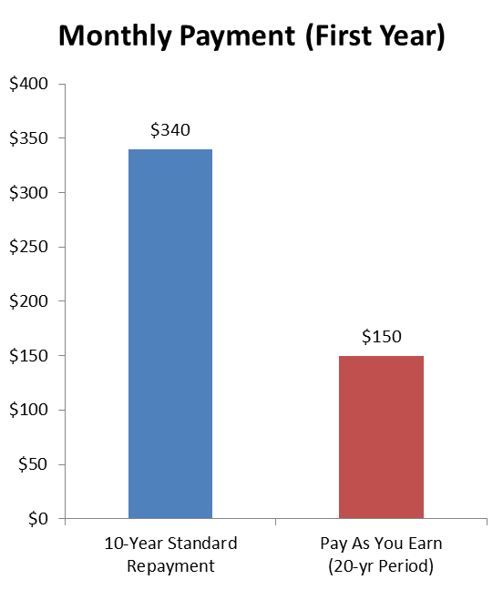
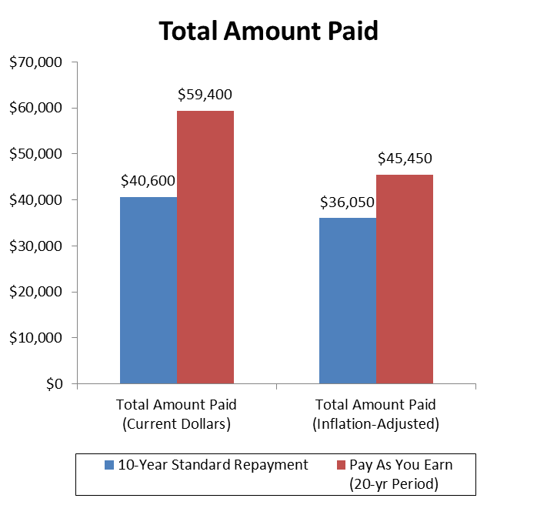
Lower Monthly Payments, Higher Total Payments
Single borrower with $29,400 in federal loans; $35,000 AGI in first year, increasing 4% a year; 6.8% interest rate

Slide 18
Other Unintended Consequences
Focusing only on monthly payments can mask total cost of education and of borrowing
Making IDR the only plan could reduce pressure on states, colleges, and the federal government to invest in higher education and need-based grant aid
In Australia and UK, mandatory IDR was introduced to generate revenue for national public systems that were not charging tuition
US has already seen tremendous cost-shifting from state to student
Without significant reforms to current college accountability systems (e.g., CDRs), it could also inadvertently create a safe haven for schools that fail to serve students well

Slide 19
Employer Withholding Not Simpler for Everyone
Employer/paycheck withholding might simplify the process for borrowers in these circumstances…
But might be complicated for borrowers in circumstances like these:
Employed full time
Has only one employer
Works year round
Files taxes as single or married filing separately
Has money on hand to cover “lumpy” costs (e.g., car repair, rent deposit, hospital bill)
Employed part time
Works multiple jobs in a year
Works at a seasonal job
Self-employed
Files taxes jointly
Not enough left after monthly bills to cover “lumpy” costs

Slide 20
Other Withholding Issues and Challenges
Making the employer a middleman adds layers of paperwork, potential for error, and privacy concerns
Prioritizes student loan payments over food, housing, or health care
Logistical challenges, such as:
How to accommodate the self-employed, seasonally employed, those with multiple jobs, etc.
How to reconcile overpayments and underpayments
How to collect payments from borrowers who are out of the country for prolonged periods
Notes:
Privacy issues:
Telling employer if you have a loan and potentially how much
Requiring all federal loan borrowers to enroll in IDR means they would have to provide pre-emptive, indefinite access to their tax information

Slide 21
Need for More Research and Data (1/2)
How do perceptions and fears about borrowing affect college-going choices, especially for lower income students?
What really works (and doesn’t work) in entrance/exit loan counseling?
How do borrowers choose repayment plans? How often do they switch? What information affects their decisions, and how?
How are borrowing decisions affected by different aspects of student loan policy, such as:
the interest rate;
monthly payment amounts;
total payment amounts;
likelihood of delinquency or default;
potential for negative amortization;
availability of loan forgiveness?
Notes:
These may be TMI for Debbie’s presentation

Slide 22
Need for More Research and Data (2/2)
What are the costs and outcomes for borrowers in IDR plans, compared to other plans? What share of borrowers in each plan are making scheduled payments, in forbearance, in deferment, delinquent, or in default?
At key intervals after entering repayment, what share of borrowers are successfully making payments, in deferment or forbearance, or heading toward delinquency or default?
How do default and loan repayment plan usage patterns vary by school and type of school?
How might changes to loan policy affect borrowers in different circumstances, such as: debt level, income, employment status, assets, age, or family status?
Notes:
These may be TMI for Debbie’s presentation

Slide 23
What We DO Know
The research is very clear about the best way to support access, success, and affordability for low-income students and families.
Reduce the need to borrow in the first place
by investing in public higher education and need-based grant aid.

Slide 24
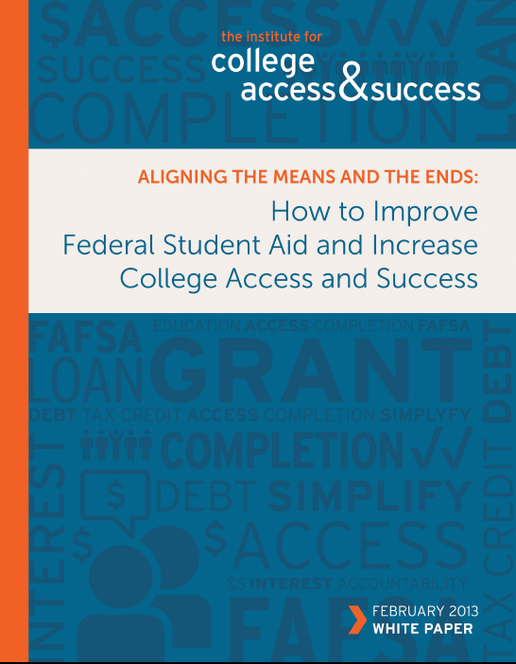
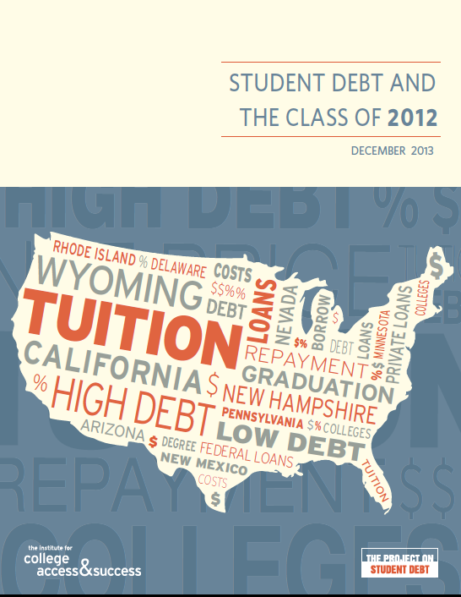
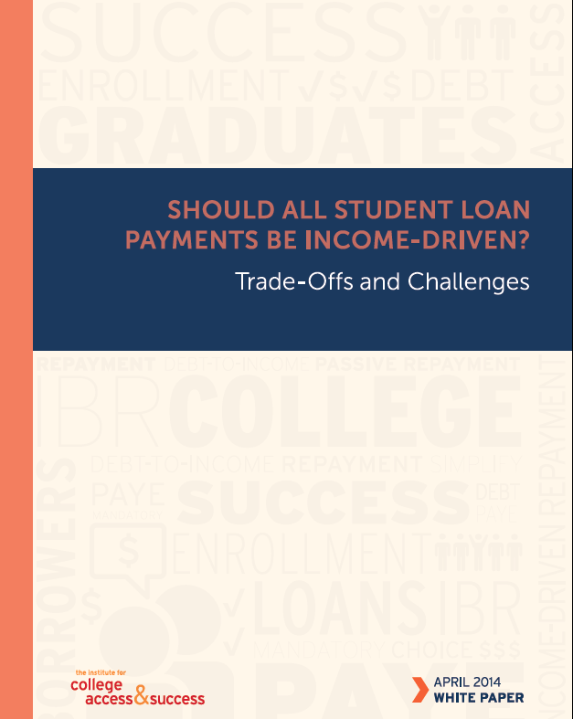
For more about our research and recommendations, see www.TICAS.org and:
Aligning the Means and the Ends: How to Improve Federal Student Aid and Increase College Access and Success (2013)
Student Debt and the Class of 2012 (2013)
Should All Student Loan Payments Be Income-Driven? (2014)

Slide 25
Questions?
Lauren Asher
ljasher@ticas.org
www.TICAS.org

